Slide 1
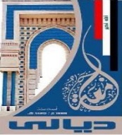

Diyala university
College of engineering
Department of computer engineering
First stage
Computer since
1-computer system Architecture
Presented By
Abdullah Thaier Abdalsatir Al-obidy

Slide 2
Overview
1. Inside a PC
2. The Motherboard
3. RAM
4. ROM
5. CMOS Memory
6. The CPU
7. Expansion Slots
8. Booting the Computer
the 'brains'
types of memory
the processor

Slide 3
1. Inside a PC
CD-ROM
drive
Power
supply
Hard disk
drive
Mother
board
Floppy
disk drive
Sound/network
cards
Wires and
ribbon cables

Slide 4
2. The Motherboard
The most important part of a PC is the motherboard. It holds:
  the processor chip
  memory chips
  chips that handle input/output (I/O)
  the expansion slots for connecting peripherals
Some chips are soldered onto the motherboard(permanent), and some are removable (so they can be upgraded).

Slide 5
A Chip
A chip (microchip) is an integrated circuit - a thin slice of silicon crystal packed with microscopic circuit elements
  e.g. wires, transistors,
  capacitors, resistors

Slide 6
Motherboard Picture
Random Access
Memory (RAM)
chips.
Read-only
Memory
(ROM)
chips
Expansion slots
Processor chip
(the CPU)

Slide 7
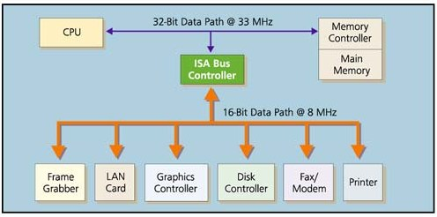
Moving Data
A data bus (a data path): connects the parts of the motherboard.
RAM
via expansion cards

Slide 8
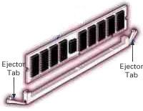
3. RAM
Random Access Memory (RAM).
RAM is used to hold programs while they are being executed, and data while it is being processed.
RAM is volatile, meaning that information written to RAM will disappear when the computer is turned off.
continued

Slide 9
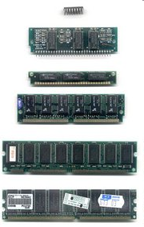
RAM contents can be accessed
in any (i.e. random) order.
By contrast, a sequential memory device, such as magnetic tape, forces the computer to access data in a fixed order because of the mechanical movement of the tape.

Slide 10
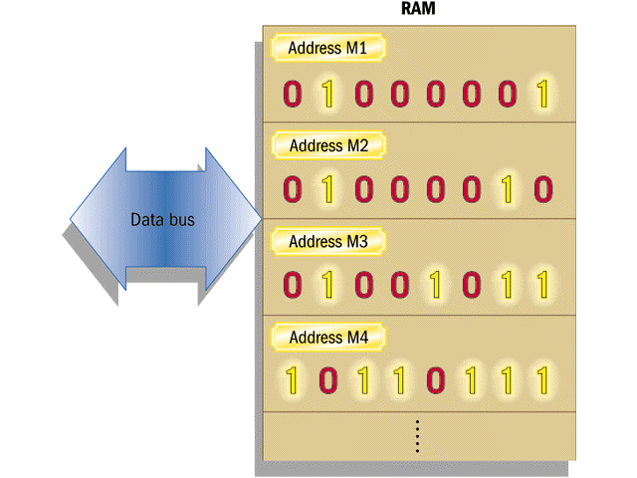
RAM Storage
Each RAM location
has an address and
holds one byte of
data (eight bits).

Slide 11
How much RAM is Enough?
Computers typically have between 64 and 512 Mb (megabytes) of RAM.
RAM access speeds can be as fast as 8 nanoseconds (8 billionth of a second).
The right amount of RAM depends on the software you are using.
You can install extra RAM.

Slide 12
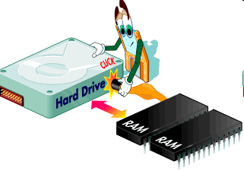
Virtual Memory
Virtual memory uses part of the hard disk to simulate more memory (RAM) than actually exists.
It allows a computer to run more programs at the same time.
Virtual memory is
slower than RAM.

Slide 13
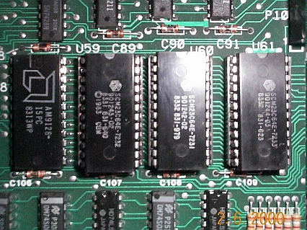
4. ROM
Read-Only Memory can
be read but not changed.
It is non-volatile storage: it remembers its contents even when the power is turned off.
ROM chips are used to store the instructions a computer needs during start-up, called firmware.
Some kinds of ROM are PROM, EPROM, EEPROM, and CD-ROM.

Slide 14
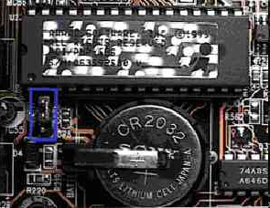
5. CMOS Memory
A computer needs a semi-permanent
way of keeping some start-up data
  e.g. the current time, the no. of hard disks
  the data may need to be updated/changed
CMOS memory requires (very little) power to retain its contents.
  supplied by a battery on the motherboard
the battery

Slide 15
6. The CPU
The Central Processing Unit (CPU) is the chip on the motherboard that acts as the "computer's brain"
  it does calculations, and coordinates the other motherboard components
  CPU examples: the Pentium, the PowerPC chip
The CPU is also known as the processor or microprocessor.

Slide 16
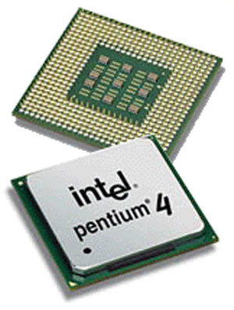
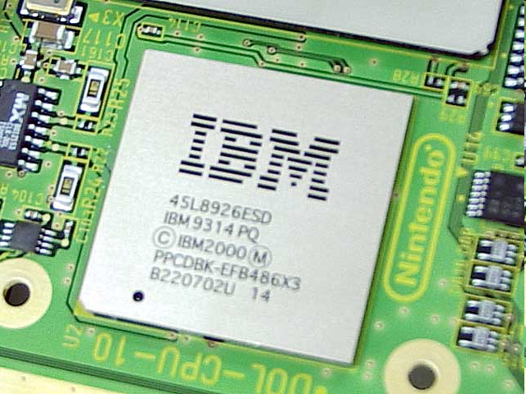
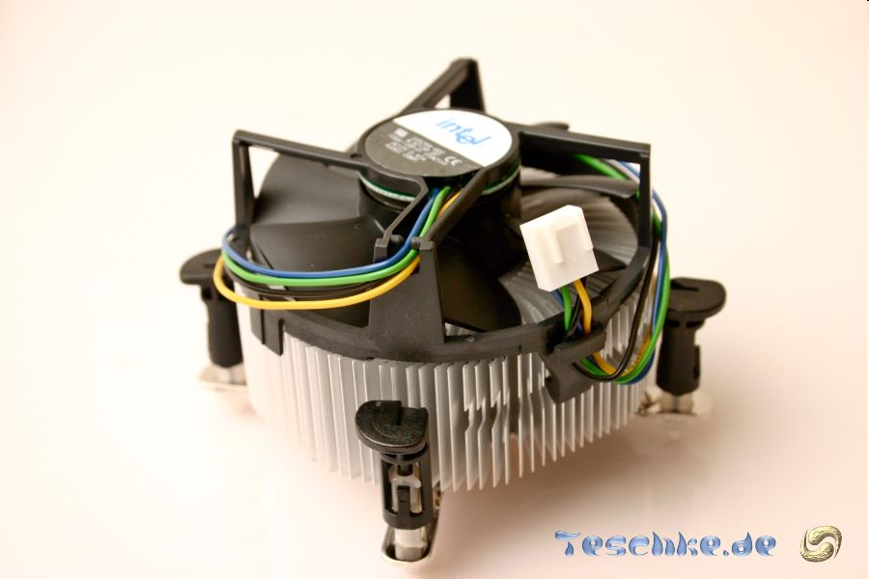
Some Processors (CPUs)
Pentium Chip
PowerPC Chip
Chip Fan

Slide 17
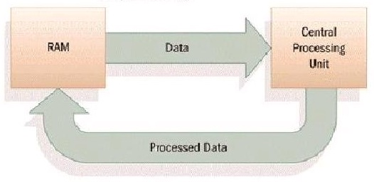
The CPU and RAM
The RAM
contains data
and programs.
The CPU
processes data.
The data bus transports the
processed data to the RAM so
it can be stored, displayed, or
output.

Slide 18
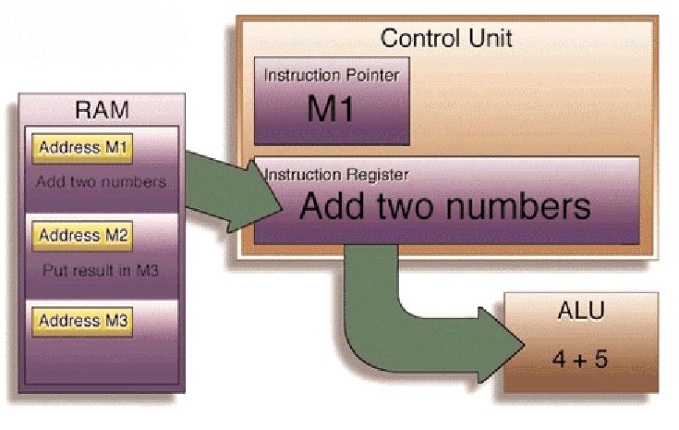
The CPU in Action
The CPU
continued

Slide 19
The instruction pointer in the CPU's control unit stores the location of the next program instruction to be executed.
The instruction is loaded into the instruction register to be carried out.
  registers are local memory on the CPU
continued

Slide 20
The ALU (arithmetic logic unit) executes the instruction.
The result is placed in the accumulator (another register), then stored back in RAM or used in other CPU operations.

Slide 21
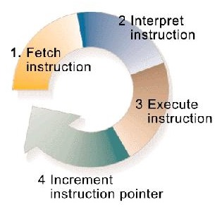
The CPU Instruction Cycle
The CPU executes a series of instructions by looping through an instruction cycle.
The speed of the
instruction cycle
is controlled by
the CPU's clock.

Slide 22
The System Clock
The system clock sends out 'ticks' to control the timing of all the motherboard tasks
  e.g. it controls the speed of the data bus and the instruction cycle
The time it takes to complete an instruction cycle is measured in megahertz (MHz).
  1 MHz = one million cycles per second

Slide 23
Two Measures of CPU Size
Word size: the number of bytes the CPU can process at once.
  depends on the number of registers in the CPU;
  depends on the size of the data bus
Cache size: the cache is high-speed memory on the CPU that stores data which is needed often.

Slide 24
7. Expansion Slots
Expansion slot containing
an expansion card.
Most expansion cards
contain a port.
Data
originates
in RAM
The expansion bus
transports data through
the motherboard.
A connector cable plugs
into the port, and leads
to a peripheral.
continued

Slide 25
Common expansion cards:
  graphics card (for connecting to a monitor)
  network card (for transmitting data over a network)
  sound card (for connecting to a microphone and speakers)
Most PCs offer 4-8 expansion slots.

Slide 26
Expansion Slot Types
There are several different types of expansion slot:
  ISA: older technology, for modems and slow devices
  PCI: for graphics, sound, video, modem or network cards
  AGP: for graphics cards

Slide 27
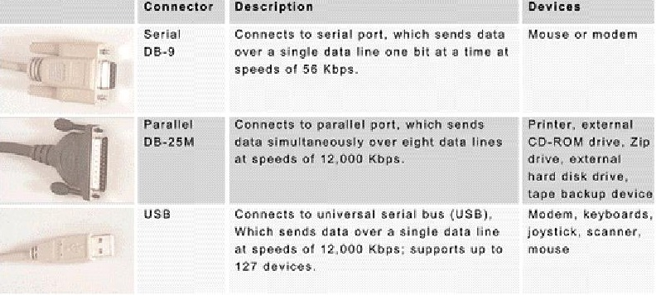
Connector Cables
continued

Slide 28
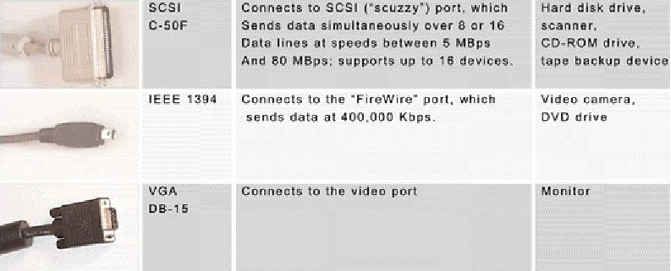

Slide 29
8. Booting a Computer
Booting is the sequence of computer operations from power-up until the system is ready for use
  this includes hardware testing, and loading the OS

Slide 30
Other Booting Tasks
The computer checks the CMOS memory.
The computer loads configuration settings from Config.sys or the Windows Registry.

Slide 31
Common Problems #1
If nothing happens, the system is not getting power.
When you turn on a computer,
you should see the power light
and hear the fan.
Fan
Power light

Slide 32
Common Problems #2
If the ROM chips, RAM, or processor are broken, then the computer will stop or 'hang'
  the light and fan will be on, but...
  there will be no messages on the screen

Slide 33
Common Problems #3
The Power-On Self-Test (POST) automatically checks for problems in the computer.
POST checks:
  the graphics card, RAM, the keyboard
  performs drives test
    hard drive, CD drives, floppy drive
Problems are reported by various beeps, or by on-screen messages.

Slide 34
Common Problems #4
Configuration data is missing or corrupted
  in the CMOS or the Windows Registry
This will generate on-screen messages.

Slide 35
Windows Safe Mode
If MS Windows cannot complete booting, it may start in Safe Mode.
Safe Mode is a limited version of Windows that allows you to use only the mouse, monitor, and keyboards
  no peripherals
  the screen icons will probably look very large

Slide 36
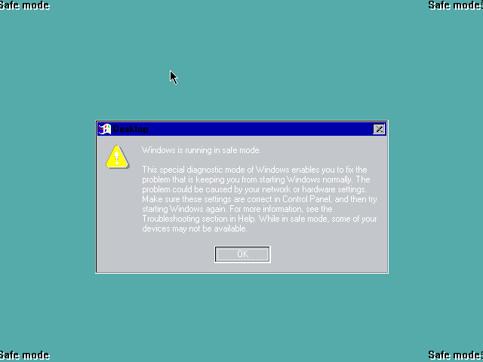
Windows Safe Mode Picture

